Slide 1

Teaching Resources and Instructors’ Guidelines
Chapter 9: Dealing with Uncertainty

Slide 2
Chapter 9: Decision-making under uncertainty
In the following PowerPoint slides you will find the key headings from CHAPTER 9 together with the main illustrations, tables, etc.
There are also slides summarizing the key messages in bullet-point fashion, and a wide range of activities which you can use to help students explore around these themes.
Finally there are some reflection questions which can be used as the basis for discussion or assignments.

Slide 3
Learning objectives
By the end of this chapter you will:
understand the need for selection decisions in innovation;
recognize the difficulties of decision-making under uncertainty;
appreciate the range of methods to forecast, select and the need to balance between speed and detail;
understand the different selection challenges across innovation space

Slide 4

Core themes and material from the book

Slide 5

Why is selection important?
  Plenty of things we could do but we have limited resources.
  Random choice is gambling.
  Innovation involves uncertainty and risk so we need ways of choosing projects to balance risk and reward.
  Building a balanced portfolio.

Slide 6
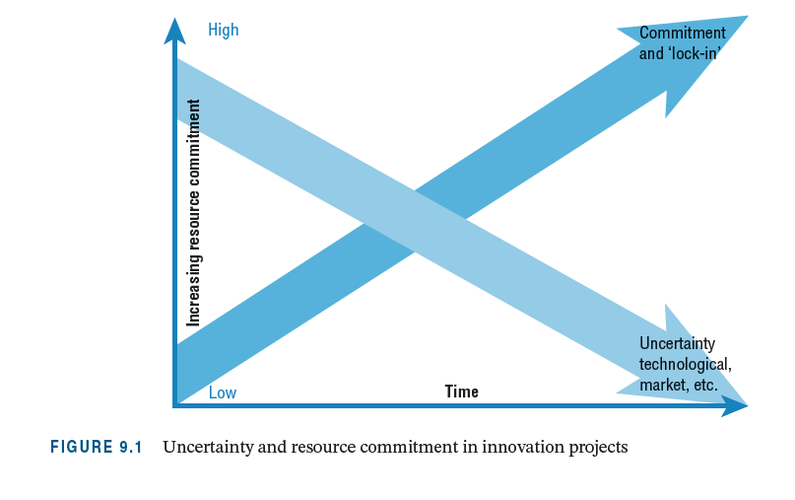
The funnel of uncertainty

Slide 7
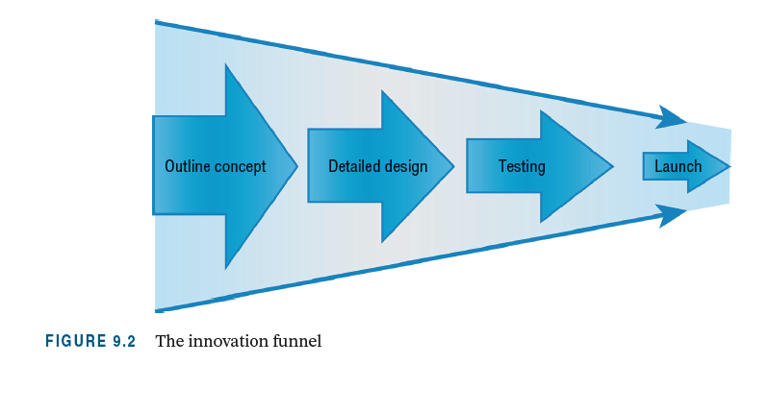
The innovation funnel

Slide 8

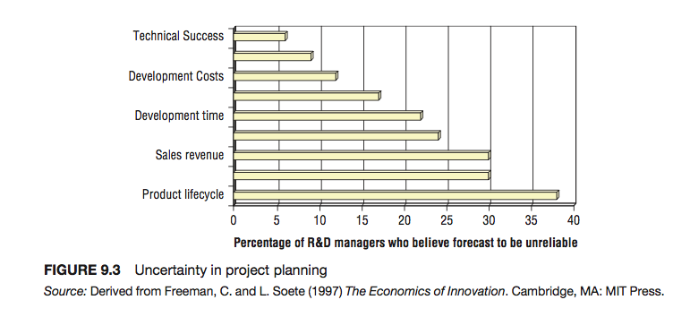
Uncertainty in project planning

Slide 9

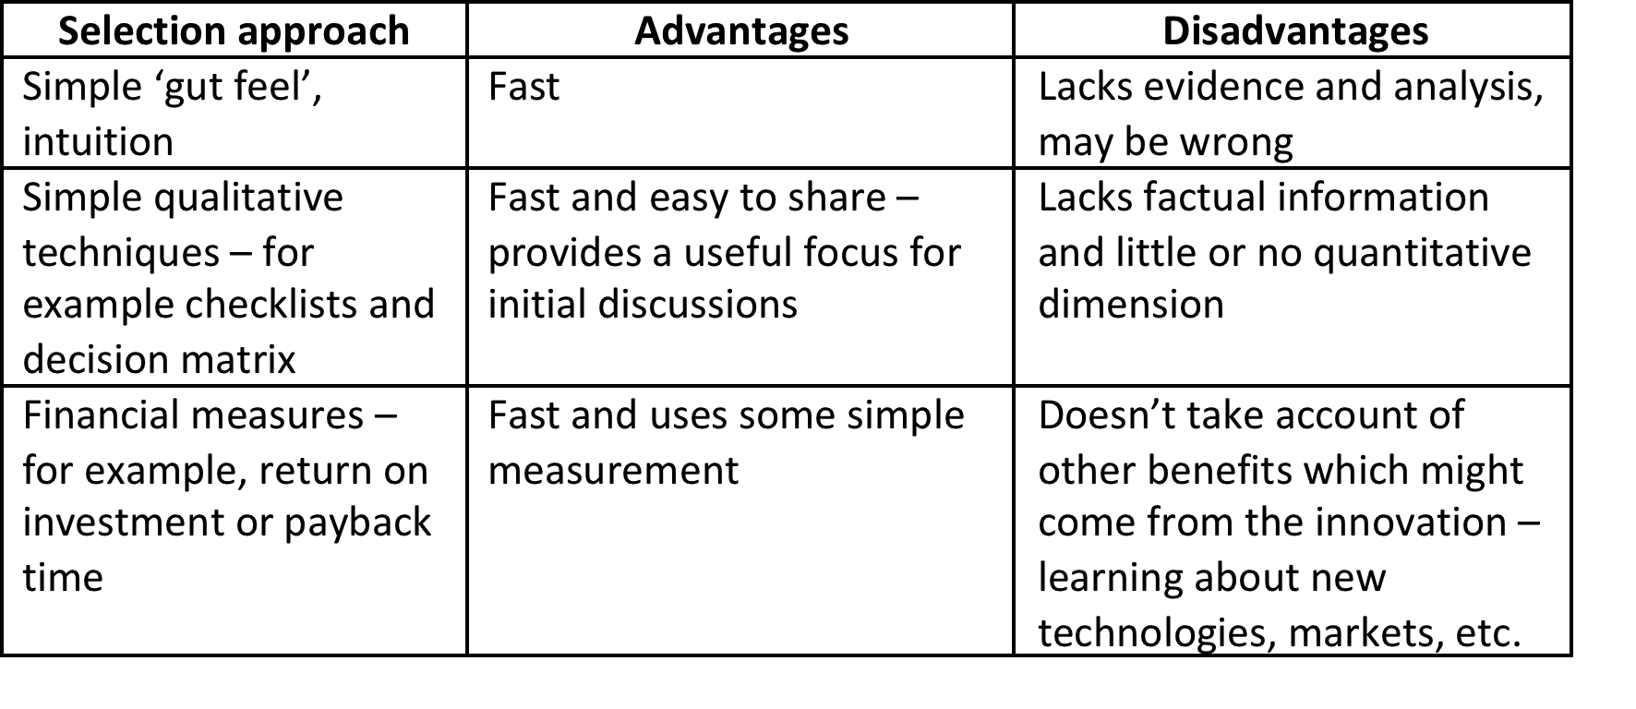
Approaches to project selection

Slide 10
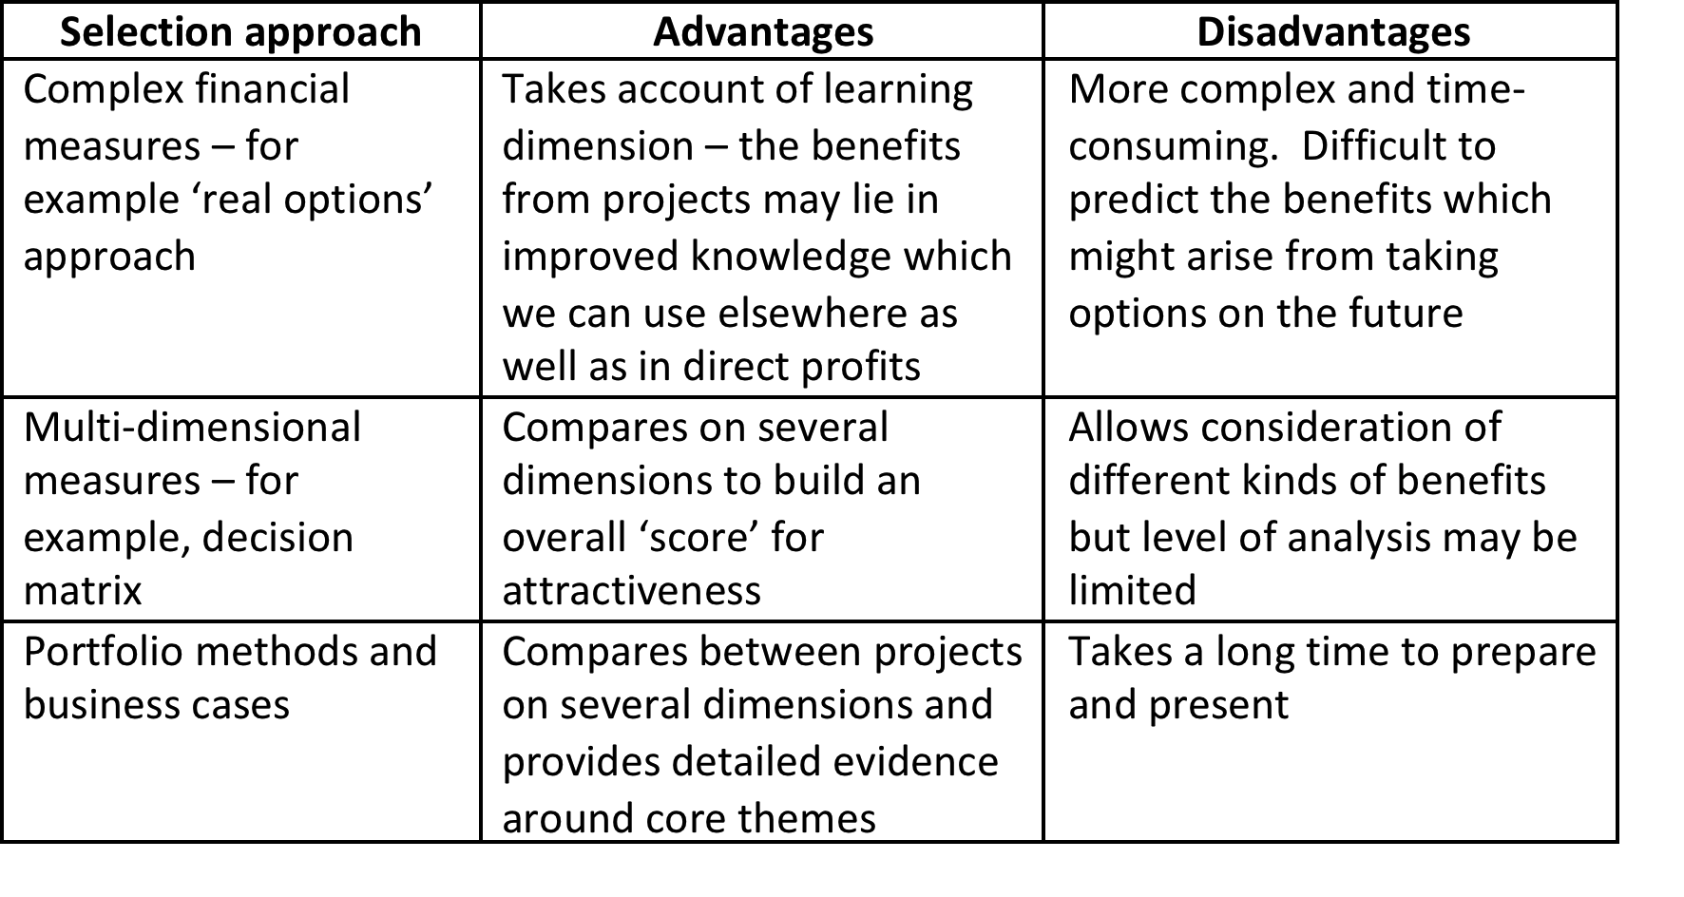
Approaches to project selection (continued)

Slide 11

Simple checklist
A list of factors which are considered important in making a decision in a specific case. Criteria include technical and commercial details, legal and financial factors, company targets and company strategy. The technique can be strengthened by:
  including some quantitative factors among the whole list of factors;
  assigning different weights to different factors;
  developing a systematic way of arriving at an overall opinion on the project, such as a score or index.

Slide 12
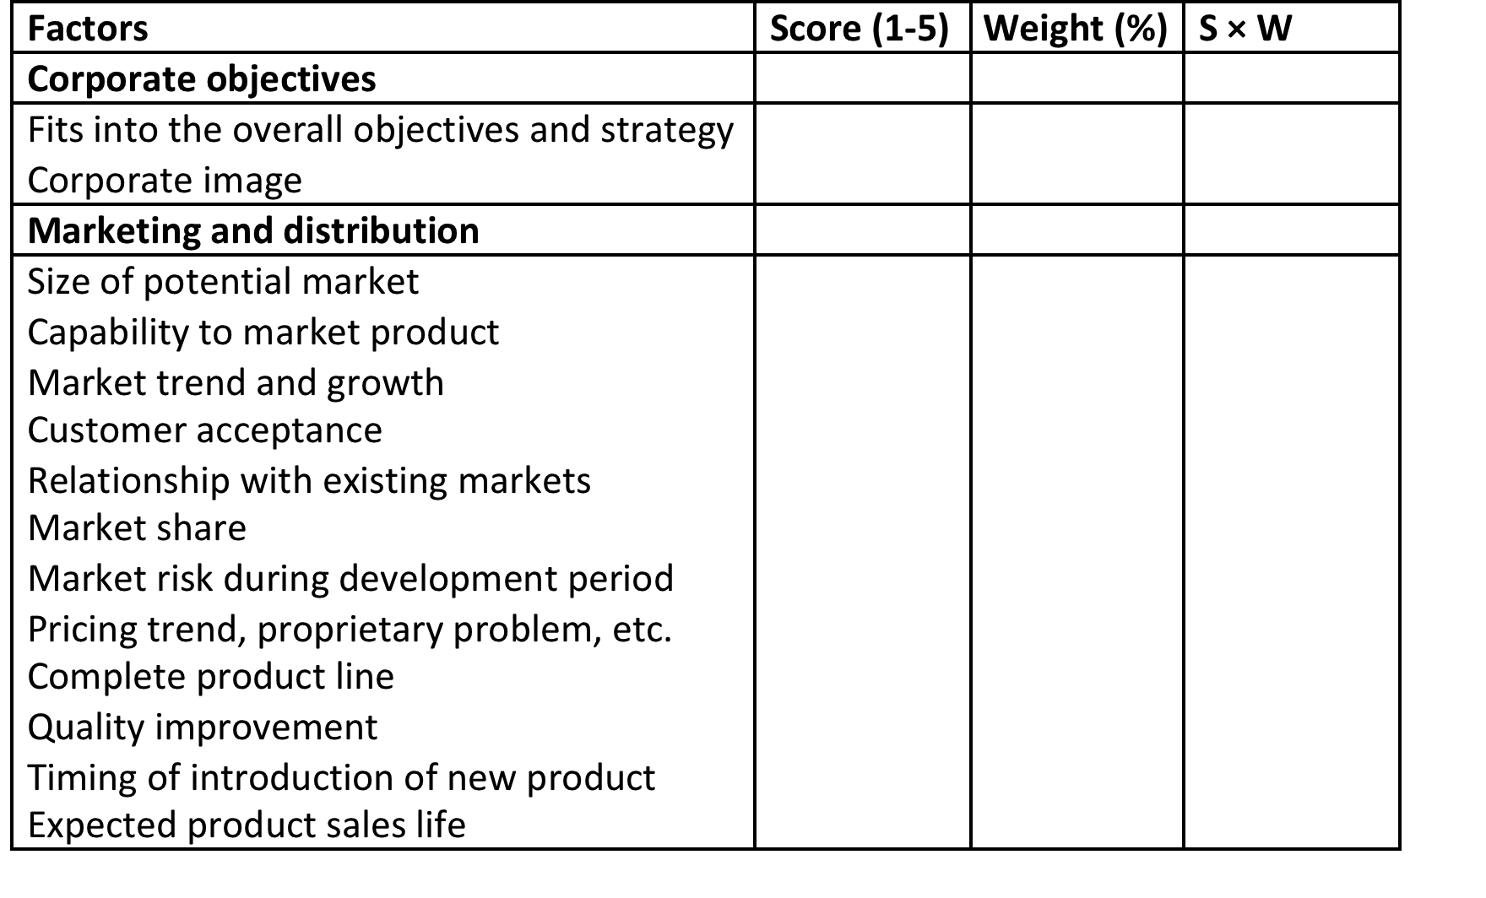
Example of a checklist

Slide 13
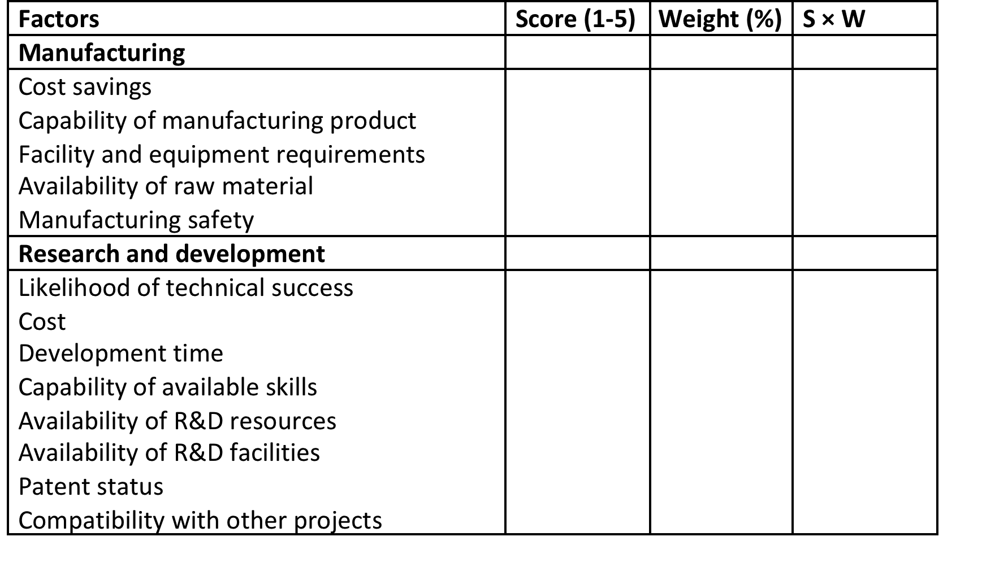
Example of a checklist (continued)

Slide 14
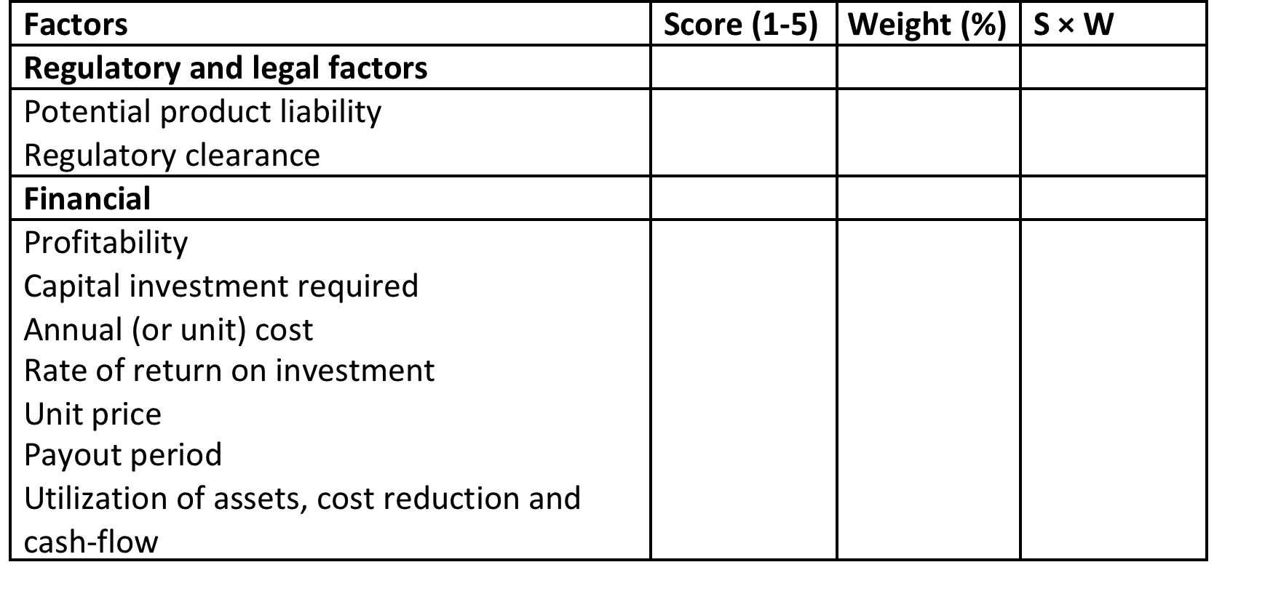
Example of a checklist (continued)

Slide 15
Business case
Business case – the story behind a proposed project should contain:
  details of the product or service;
  assessment of the market opportunity;
  identification of target customers;
  barriers to entry and competitor analysis;
  experience, expertise and commitment of the management team;
  strategy for pricing, distribution and sales;
  identification and planning for key risks;
  cash-flow calculation, including breakeven points and sensitivity;
  financial and other resource requirements of the business.

Slide 16

Forecasting innovation
Choice of method depends on:
  • what we are trying to forecast
  • rate of technological and market change
  • availability and accuracy of information
  • the company’s planning horizon
  • the resources available for forecasting.

Slide 17
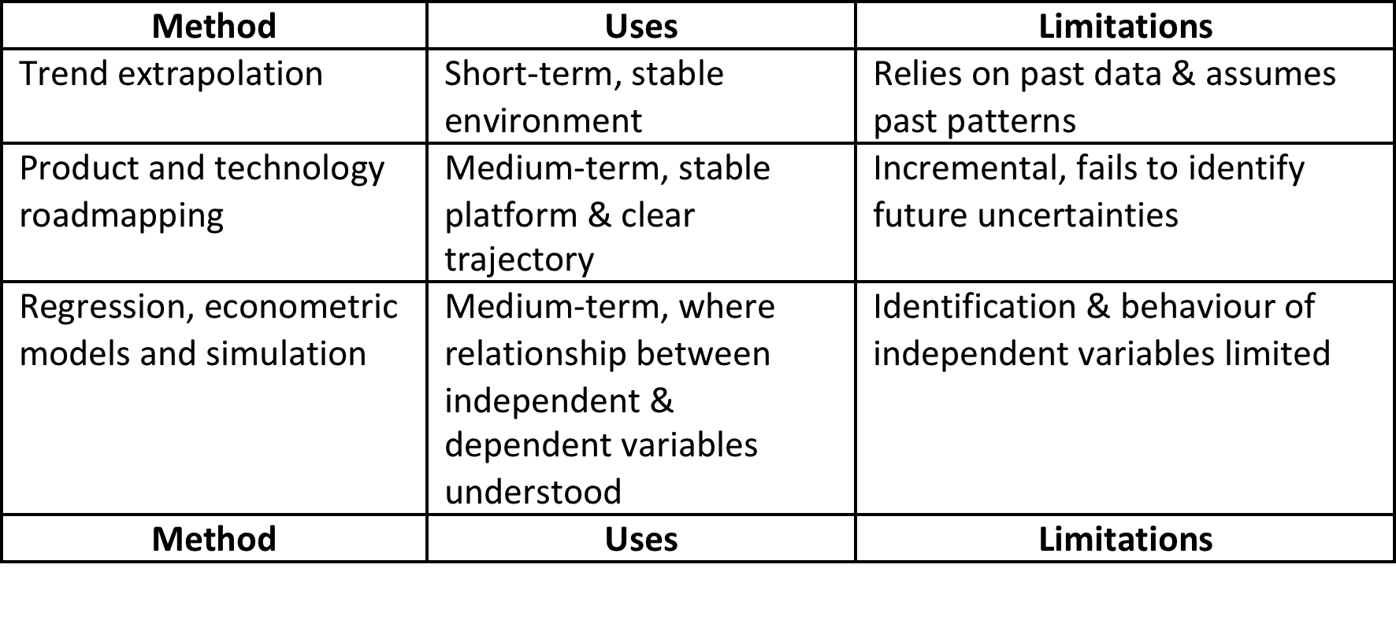
Types of forecasting

Slide 18
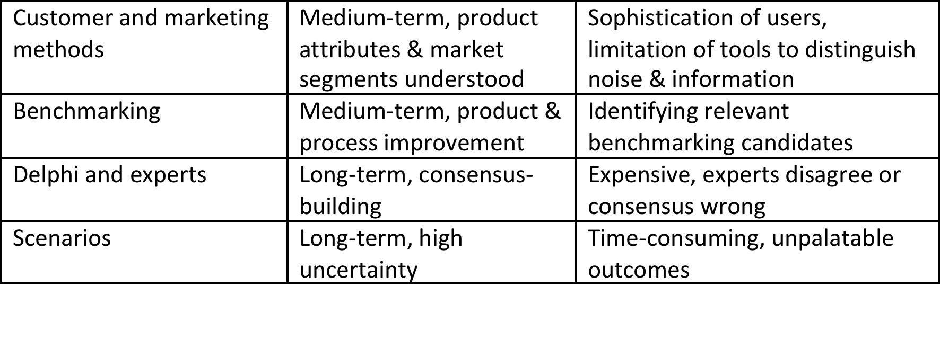
Types of forecasting (continued)

Slide 19
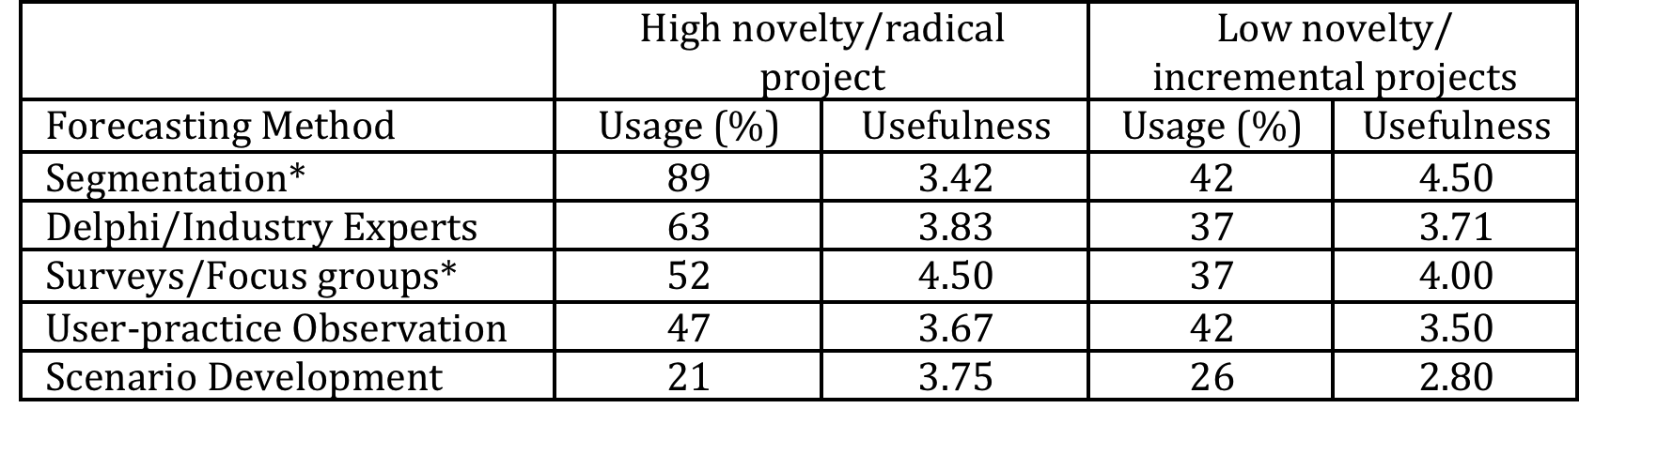
Use of forecasting
Usefulness Scale: 1-5, 5=critical, based on manager assessments of 50 development projects in 25 firms. * denotes difference in usefulness rating is statistically significant at 5% level
Source: Adapted from Tidd, J. and Bodley, K. (2002) ‘The affect of project novelty on the new product development process’, R&D Management, 32(2), 127-138.

Slide 20
The most common forecasting methods
  customer or market surveys;
  internal analysis (e.g. brainstorming);
  external analysis (e.g. benchmarking);
  external analysis (e.g. Delphi or expert opinion);
  scenario development.

Slide 21
The problem of multiple projects
The problem of multiple projects:
  Business case OK for single project.
  How to assess competing projects?
  Need to balance risk and reward.
  Need for portfolio management.

Slide 22
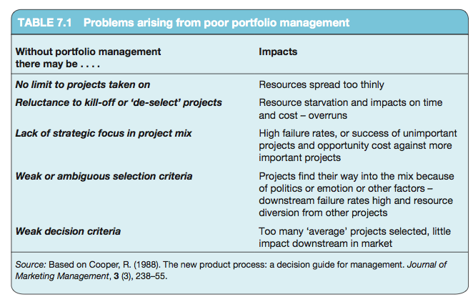
Problems due to lack of portfolio management

Slide 23
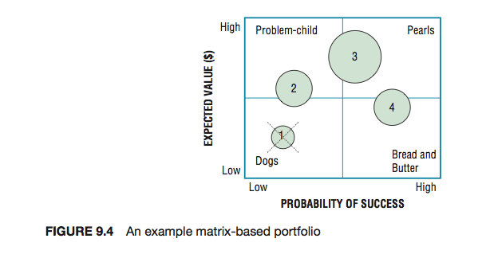
Example of a bubble chart

Slide 24
The A D Little matrix
A D Little matrix groups technological knowledge into four key groups: base, key, emerging and pacing.
Making this distinction helps: identify a strategy for acquisition based on the degree of potential impact; the importance to the enterprise; the protectability of the knowledge.
Models of this can be refined, for example, by adding to the matrix information about different markets and their rate of growth or decline

Slide 25
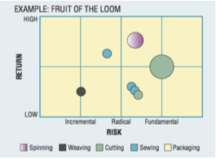
Example of a bubble chart

Slide 26
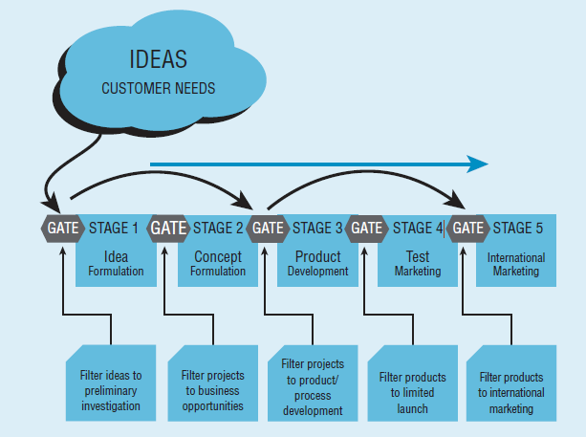
Example of stage gate system

Slide 27
Implementing a stage gate system
The case of ABC Electronics describes the design and implementation of a stage gate system.
See the website for this and other cases

Slide 28
Dealing with radical innovation
Problem is such high uncertainty that it becomes hard to evaluate.
Risk is that organization rejects these options.
Need some way of handling and evaluating these projects.

Slide 29
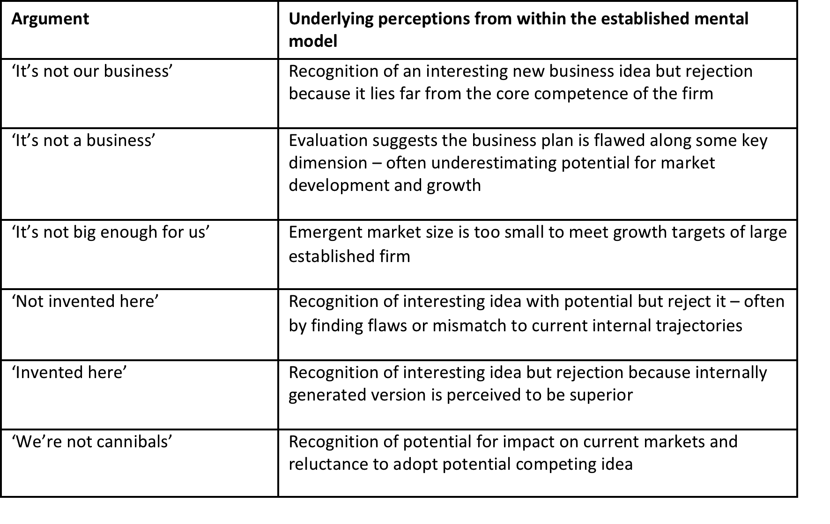
Typical reactions to ‘wild’ ideas

Slide 30
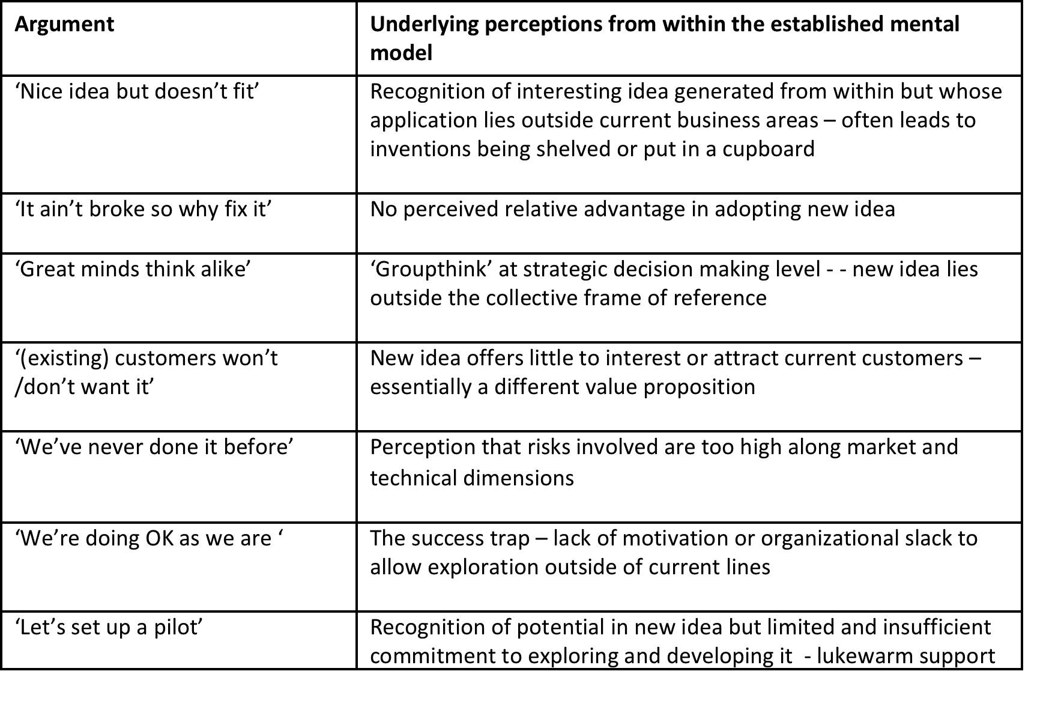
Typical reactions to ‘wild’ ideas (continued)

Slide 31
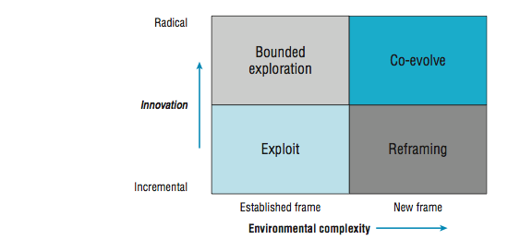
A map of innovation selection space

Slide 32
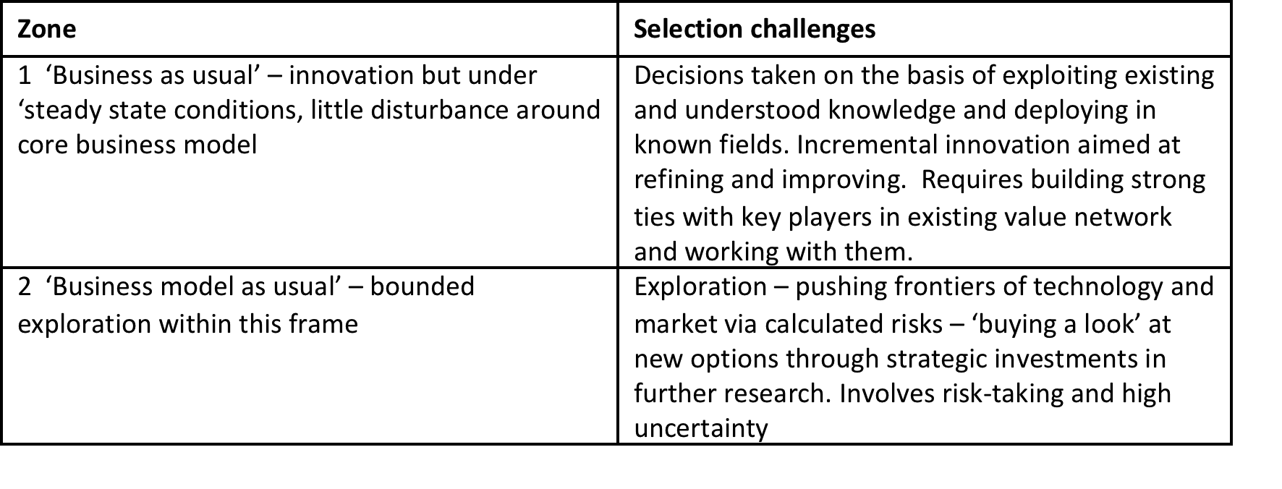
Selection challenges mapped on to the model

Slide 33
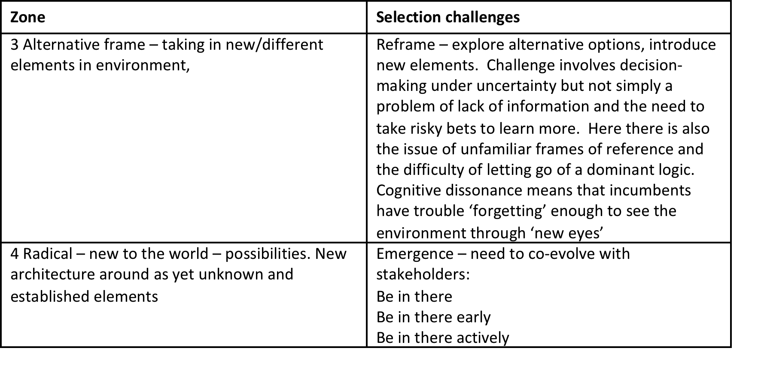
Selection challenges mapped on to the model (continued)

Slide 34
Summary
In this chapter we have looked at some of the challenges in making the selection decision – moving from considering all the possible trigger signals about what we could do in terms of innovation to committing resources to some particular projects.
This quickly raises the issue of uncertainty and how we convert it to some kind of manageable risk – and build a portfolio of projects spreading this risk.

Slide 35
Summary
Tools and techniques for doing so for incremental innovation are relatively straightforward (though there is never a guarantee of success), but as we increase the radical nature of the innovation there is a need for different approaches.

Slide 36
Summary
The problem is further compounded because of the simplifying assumptions we make when framing the complex world – and the risk is that in selecting projects which fit our frame we may miss important opportunities or challenges. For this reason we need techniques which help the organization look and make decisions ‘outside the box’.

Slide 37

Videos
There are several videos which can help explore and present the key themes of the chapter:
Selecting innovation opportunities Selecting selection
Portfolio management
Business models part 1
Business models part 2
Radical selection
Notes:
Short videos

Slide 38
Videos
On the website there is a video interview with Michael Bartl of Hyve, talking about the use of ‘netnography’ in the search for new innovation opportunities

Slide 39
Blogs and podcasts
There are several podcasts and blogs picking up key themes around managing innovation as a process and some of the key variables:

Slide 40
Activities
There are a variety of activities (for both groups and individuals and for online as well as offline work. These include:

Slide 41
Activity: Market research toolkit
Ask students to pick one of the tools in the Market research toolkit and apply it to try and explore the potential market for a new product or service idea

Slide 42
Activity: Bubble charts
On the website there is activity for students with bubble charts as a tool

Slide 43
Activity: Business model canvas
Business models provide a powerful way of representing how an innovation will create and deliver value.
On the website there is the activity build on the framework of the Business Model Canvas to help develop thinking around business models

Slide 44
Team project exercises
Choose a new service innovation and then, working as a group, try and ‘reverse engineer’ the way the business case for this was developed. Use the framework of the Business Model Canvas to help focus your research.

Slide 45
Cases
There are several case studies on the website which highlight key themes in the chapter, including:
The Plaswood Recycling case, which provides a good example of how to assess a new business concept
Philips Lighting describing how the transition in the underlying mindset when faced with radical innovation was managed
Lufthansa Systems and Liberty Global using different evaluation approaches in the context of online innovation platforms
Gunfire at sea - a famous case study which highlights the challenges of introducing radical ideas into established organizations.

Slide 46
Research study and examples
This AIM (Advanced Institute of Management Research) report on “Radical innovation – Making the right bets” looks at some of the challenges in radical project selection

Slide 47
Tools
There are a variety of tools which can help deal with themes raised in this chapter. You can find them all on the website here
Cause and effect analysis
Decision matrix
Delphi method
Failure Mode and Effect analysis (FMEA)
Risk assessment matrix
Scenario development
Market research toolkit
Portfolio management
Boston Box
Stage gate methods
Bubble charts
Business case
Business model Canvas
Entrepreneur’s storyboard

Slide 48
Assessments
The following slides offer some example assessment questions and discussion themes for individual or group activity

Slide 49
Assessment and discussion questions
1. How might an organization assess a portfolio of possible innovation projects? What are the relative strengths and weaknesses of different approaches?
2. You have been asked to help implement a stage gate system within an organization. What factors would you consider in design and introduction of this approach?

Slide 50
Assessment and discussion questions
3. Jane Wilson has a great new idea for an internet-based service business helping match students to internship opportunities. What factors should she consider in developing a business plan for this?
4. What typical problems emerge as a result of a lack of portfolio management?

